Slide 1
Ethereum and Solidity
CST 428 BLOCK CHAIN TECHNOLOGIES
S8 CSE – ELECTIVE
MODULE – 5

Slide 2
Ethereum – an overview
idea proposed was the development of a Turing-complete language that allows the development of arbitrary programs (smart contracts) for blockchain and Decentralized Applications (DApps)
first version of Ethereum, called Olympic, was released in May, 2015
Two months later, Frontier was released in July

Slide 3
Ethereum – an overview
Another version named Homestead with various improvements was released in March, 2016
The latest Ethereum release is called Muir Glacier

Slide 4
The Ethereum network
a peer-to-peer network where nodes participate in order to
maintain the blockchain and contribute to the consensus mechanism
Networks can be divided into three types, based on the requirements and usage
The mainnet - current live network of Ethereum with network ID and chain ID as 1 to identify the network

Slide 5
The Ethereum network
Testnets - to provide a testing environment for smart contracts and DApps before being deployed to the production live blockchain
Also allow experimentation and research
Example - Ropsten, Kovan and Rinkeby,

Slide 6
The Ethereum network
Private nets - private networks that can be created by generating a new genesis block in private blockchain networks, where a private group of entities start their blockchain network and use it as a permissioned or consortium blockchain

Slide 7
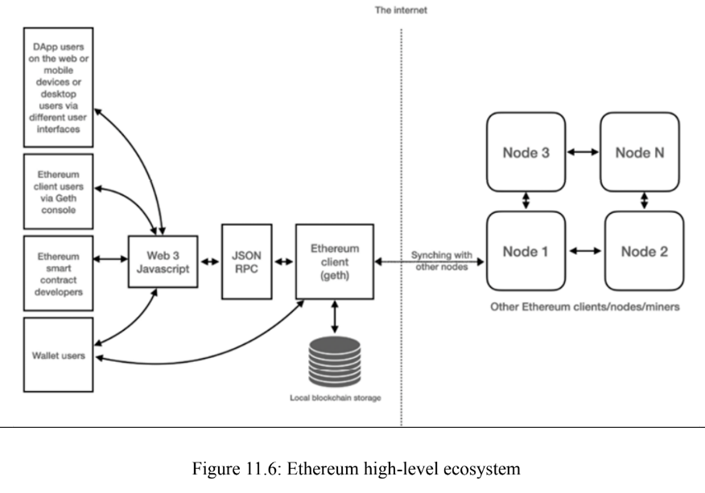
Components of the Ethereum ecosystem

Slide 8
The Ethereum network
elements present in the Ethereum blockchain is
Keys and addresses
Accounts
Transactions and messages
Ether cryptocurrency/tokens
The EVM
Smart contracts and native contracts

Slide 9
Keys and addresses
to represent ownership and transfer ether
keys are made up of pairs of private and public parts
Private key is generated randomly and is kept secret, whereas a public key is derived from the private key
Addresses are derived from public keys and are 20-byte codes used to identify accounts

Slide 10
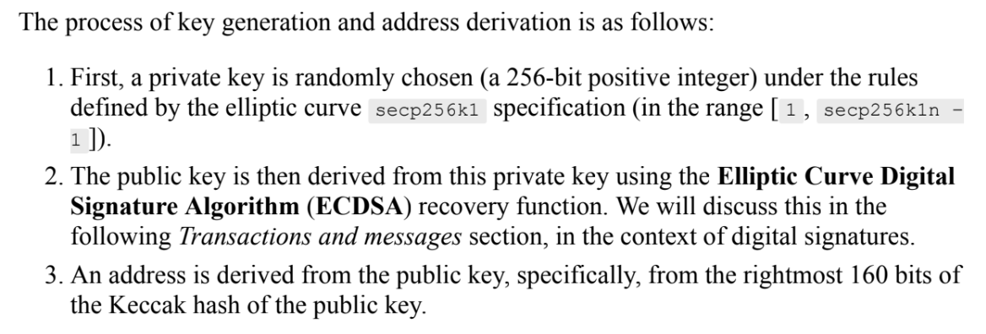
Keys and addresses

Slide 11
Accounts
one of the main building blocks of the Ethereum blockchain
defined by pairs of private and public keys
used to interact with the blockchain via transactions
A transaction is digitally signed by an account before submitting it to the network via a node
Ethereum, being a transaction-driven state machine, the state is created or updated as a result of the interaction between accounts and transaction executions

Slide 12
Accounts
All accounts have a state that, when combined together, represents the state of the Ethereum network
With every new block, the state of the Ethereum network is updated
Operations performed between and on the accounts represent state transitions
The state transition is achieved using Ethereum state transition function

Slide 13
Accounts
Working of Ethereum state transition function
Confirm the transaction validity by checking the syntax, signature validity, and nonce
The transaction fee is calculated, and the sending address is resolved using the signature. the sender's account balance is checked and subtracted accordingly, and the nonce is incremented. An error is returned if the account balance is insufficient

Slide 14
Accounts
Working of Ethereum state transition function
Provide enough ETH (the gas price) to cover the cost of the transaction
This is charged per byte and is incrementally proportional to the size of the transaction
In cases of transaction failure due to insufficient account balance or gas, all state changes are rolled back except for the fee payment, which is paid to the miners

Slide 15
Accounts
Working of Ethereum state transition function
the remainder (if any) of the fee is sent back to the sender as change and the fee is paid to the miners accordingly. At this point, the function returns the resulting state, which is also stored on the blockchain

Slide 16
Accounts
Two types
Externally Owned Accounts (EOAs) - similar to accounts that are controlled by a private key in Bitcoin
Contract Accounts (CAs) - accounts that have code associated with them along with the private key

Slide 17
Properties of Accounts
EAOs | CAs
have a state associated with a human user, hence are also called user accounts EOAs have an ether balance capable of sending transactions no associated code controlled by private keys EOAs cannot initiate a call message Accounts contain a key-value store EOAs can initiate transaction messages | have a state not intrinsically associated with any user or actor on the blockchain CAs have an ether balance They have associated code that is kept in memory/storage on the blockchain have access to storage can get triggered and execute code in response to a transaction or a message from other contracts can maintain their permanent states and can call other contracts cannot start transaction messages can initiate a call message contain a key-value store addresses are generated when they are deployed

Slide 18
Transactions
A transaction in Ethereum - digitally signed data packet using a private key that contains the instructions that, when completed, either result in a message call or contract creation
two types based on the output they produce:
Message call transactions: simply produces a message call that is used to pass messages from one CA to another
Contract creation transactions: result in the creation of a new CA

Slide 19
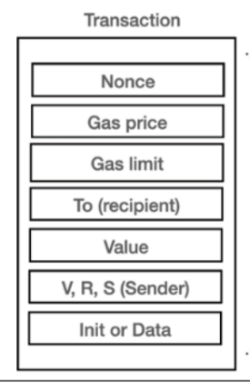
Unique identifier incremented by one every time a transaction is sent by the sender
amount of Wei required to execute the transaction
value that represents the maximum amount of gas that can be consumed to execute the transaction
20 byte value address
total number of Wei to be transferred to the recipient
Init field is used only in transactions that are intended to create contracts
If the transaction is a message call, then the Data field is used instead of init, and represents the input data of the message call
digital signature (R, S) and some information that can be used to
recover the public key (V)
Wei is the smallest denomination of ether

Slide 20
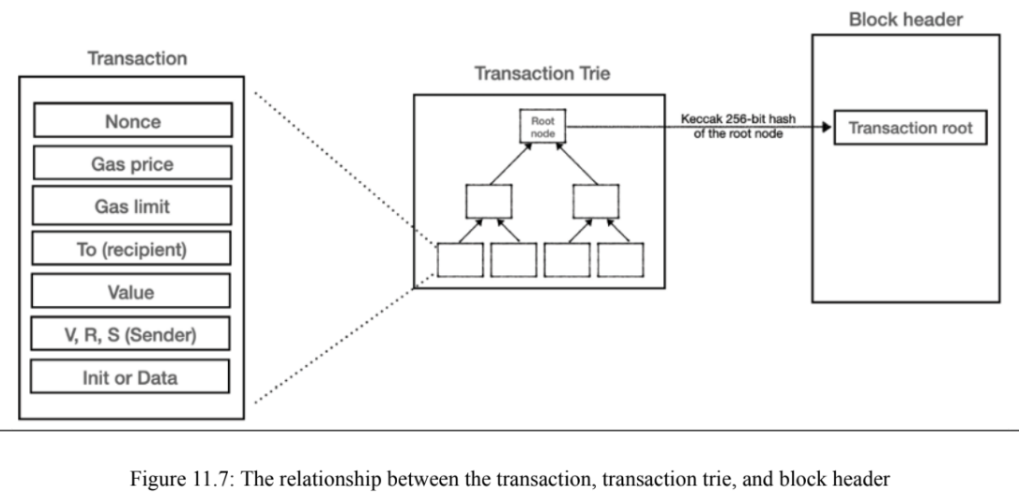

Slide 21
Messages
a data packet passed between two accounts
can either be sent via a smart contract (autonomous object) or from an external actor (an Externally Owned Account, or EOA) in the form of a transaction that has been digitally signed by the sender
Contracts can send messages to other contracts
Messages only exist in the execution environment and are never stored

Slide 22
Messages
Messages are produced by the contracts, whereas transactions are produced by entities external to the Ethereum environment (EOAs)
Messages are generated when the CALL or DELEGATECALL opcodes are executed by the contract running in the EVM

Slide 23
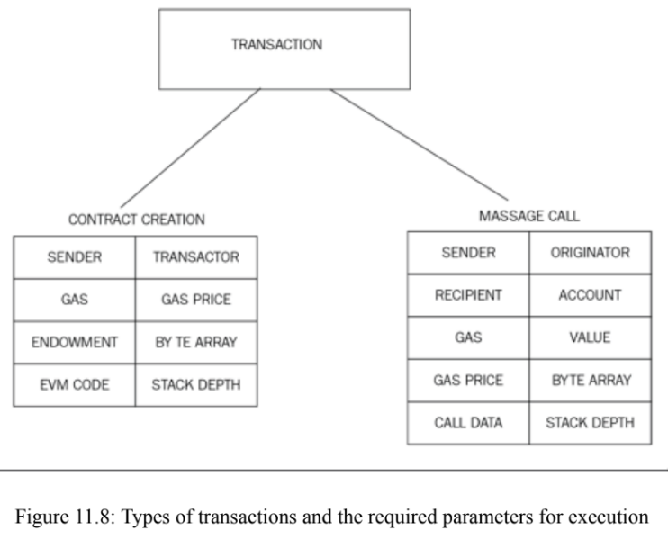

Slide 24
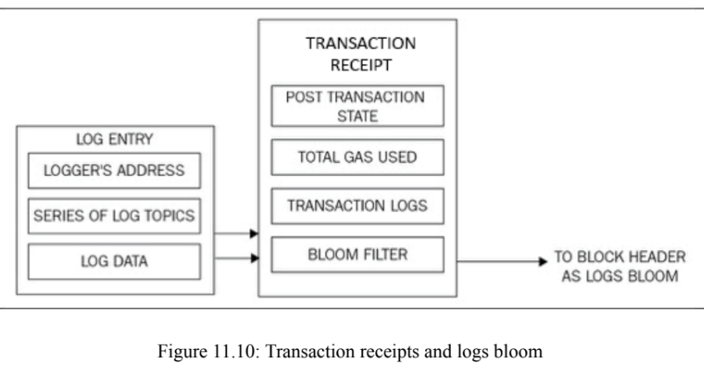

Slide 25
The Ethereum Virtual Machine (EVM)
simple stack-based execution machine that runs bytecode instructions to transform the system state from one state to another
word size of the EVM is set to 256-bit
stack size is limited to 1,024 elements based LIFO
Turing-complete machine but is limited by the amount of gas that is required to run any instruction

Slide 26
The Ethereum Virtual Machine (EVM)
infinite loops that can result in denial-of-service attacks are not possible due to gas requirements
Supports exception handling by immediately halt and return the error to the executing agent
EVM is an entirely isolated and sandboxed runtime environment
The code that runs on the EVM does not have access to any external resources such as a network or filesystem

Slide 27
The Ethereum Virtual Machine (EVM)
This results in increased security, deterministic execution, and allows untrusted code (code that can be run by anyone) to be executed on Ethereum blockchain

Slide 28
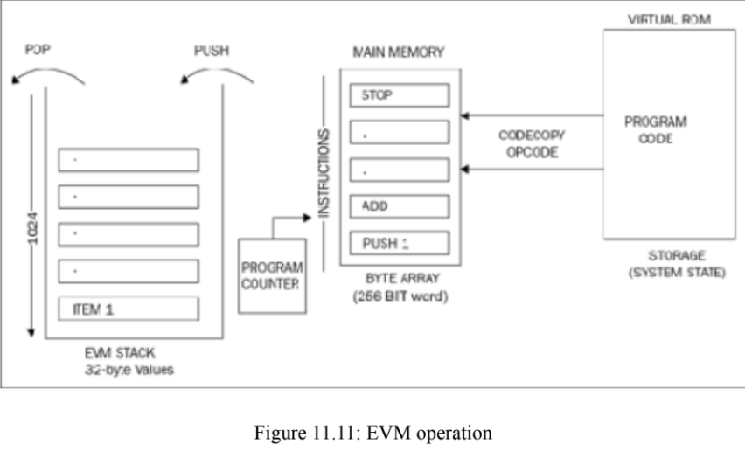

Slide 29
Blocks and blockchain
main building structure of a blockchain
Ethereum blocks consist of
The block header
The transactions list
The list of headers of ommers or uncles
An uncle block is a block that is the child of a parent but does not have any child block. Ommers or uncles are valid, but stale, blocks that are not part of the main chain but contribute to security of the chain. They also earn a reward for their participation but do not become part of the canonical truth.

Slide 30
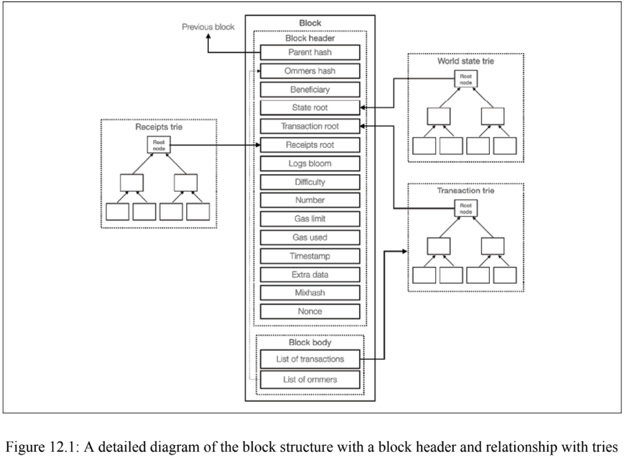
160-bit address of the recipient that will receive the mining reward once the block is successfully mined.
difficulty level of the current block
to store arbitrary data related to the block. Only up to 32 bytes
total number of all previous blocks
used to prove that adequate computational effort (Proof of Work, or PoW) has been spent in order to create this block.

Slide 31
Block finalization
Block finalization is a process that is run by miners to validate the contents of the block and apply rewards
4 steps
Ommers validation - checks whether the header is valid and whether the relationship between the uncle and the current block satisfies the maximum depth of six blocks and a block can contain a maximum of two uncles

Slide 32
Block finalization
4 steps
Transaction validation - checking whether the total gas used in the block is equal to the final gas consumption after the final transaction
Reward application - updating the beneficiary's account with a reward balance. Current block reward is 2 ether
State and nonce validation - compute a valid state and block nonce

Slide 33
Block difficulty mechanism
Block difficulty is increased if the time between two blocks decreases, whereas it increases if the block time between two blocks decreases
This is required to maintain a roughly consistent block generation time
The difficulty adjustment algorithm in Ethereum's Homestead release is as follows

Slide 34
Block difficulty mechanism
if the time difference between the generation of the parent block and the current block is less than 10 seconds, the difficulty goes up by parent_diff // 2048 * 1
If the time difference is between 10 and 19 seconds, the difficulty level remains the same
Finally, if the time difference is 20 seconds or more, the difficulty level decreases
This decrease is proportional to the time difference from parent_diff // 2048* -1 to a maximum decrease of parent_diff // 2048 * -99

Slide 35
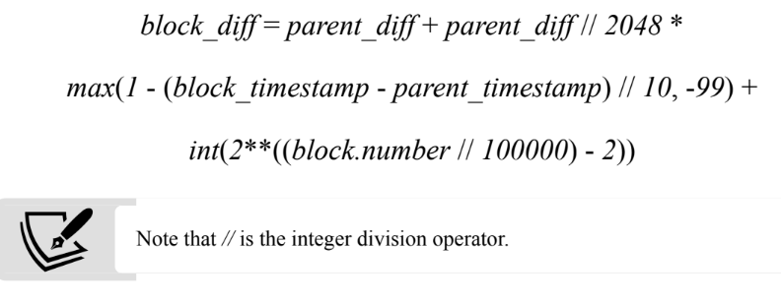
Block difficulty mechanism

Slide 36
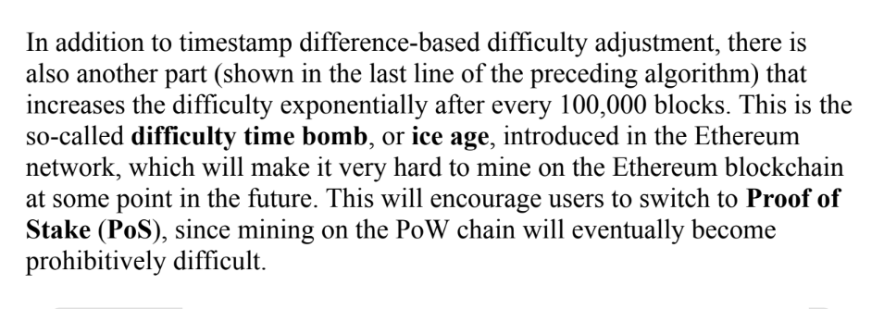
Block difficulty mechanism

Slide 37
Gas
Gas is required to be paid for every operation performed on the Ethereum blockchain
mechanism that ensures that infinite loops cannot cause the whole blockchain to stall due to the Turing-complete nature of the EVM
transaction fee is charged as an amount of Ether and is taken from the account balance of the transaction originator

Slide 38
Gas
A fee is paid for transactions to be included by miners for mining
If this fee is too low, the transaction may never be picked up
the more the fee, the higher are the chances that the transactions will be picked up by the miners for inclusion in the block
if the transaction that has an appropriate fee paid is included in the block by miners but has too many complex operations to perform, it can result in an out-of-gas exception if the gas cost is not enough

Slide 39
Gas
the transaction will fail but will still be made part of the block, and the transaction originator will not get any refund
Transaction costs can be estimated using the following formula:
Total cost = gasUsed * gasPrice
gasUsed is the total gas that is supposed to be used by the transaction during the execution, and gasPrice is specified by the transaction originator as an incentive to the miners to include the transaction in the next block

Slide 40
Gas
This is specified in ETH
Each EVM opcode has a fee assigned to it
It is an estimate because the gas used can be more or less than the value specified by the transaction originator originally

Slide 41
Solidity
statically-typed (type checking at compile time) curly-braces object-oriented programming language designed for developing smart contracts that run on Ethereum
domain-specific language of choice for programming contracts in Ethereum
syntax is closer to both JavaScript and C
also called a contract-oriented language

Slide 42
The layout of a Solidity source code file
contracts are equivalent to the concept of classes
three types of variables in Solidity: local variables, global variables, and state variables
State variables have their values permanently stored in smart contract storage
State variables are declared outside the body of a function, and they remain available throughout the contract depending on the accessibility assigned to them and as long as the contract persists

Slide 43
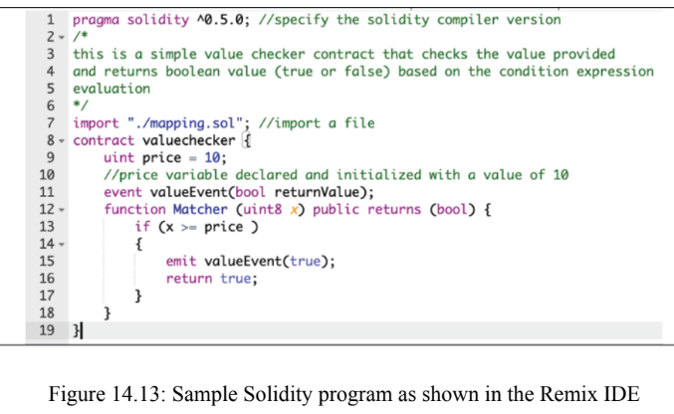

Slide 44
The layout of a Solidity source code file
Solidity has two categories of data types: value types and reference types
Reference types store the address of the memory location where the value is stored
Value types mainly include Booleans, integers, addresses, and literals

Slide 45
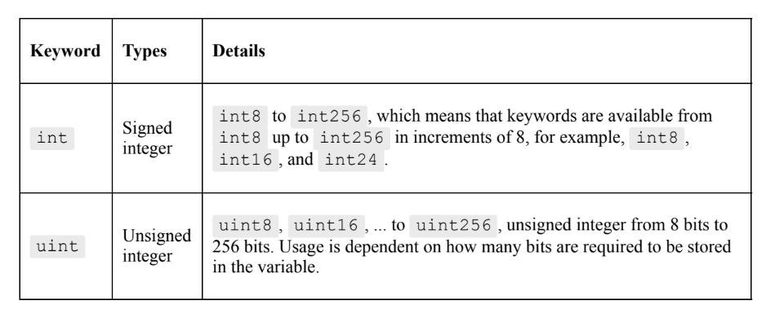
Data Types
Boolean - true or false

Slide 46
Data Types
Address -holds a 160-bit long (20 byte) value
has several members that can be used to interact with and query the contracts
Balance: returns the balance of the address in Wei
Send: used to send an amount of ether to an address and returns true or false depending on the result of the transaction

Slide 47
Data Types
Address -holds a 160-bit long (20 byte) value
Call functions: call , callcode , and delegatecall functions
to interact with functions that do not have an ABI (Application Binary Interface)
Array value types (fixed-size and dynamically sized byte arrays): Fixed-size keywords range from bytes1 to bytes32 , whereas dynamically sized keywords include bytes and string

Slide 48
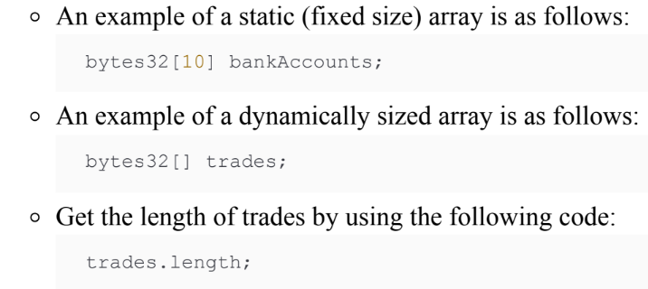
Data Types
Address -holds a 160-bit long (20 byte) value
The bytes keyword is used for raw byte data, and string is used for strings encoded in UTF-8

Slide 49
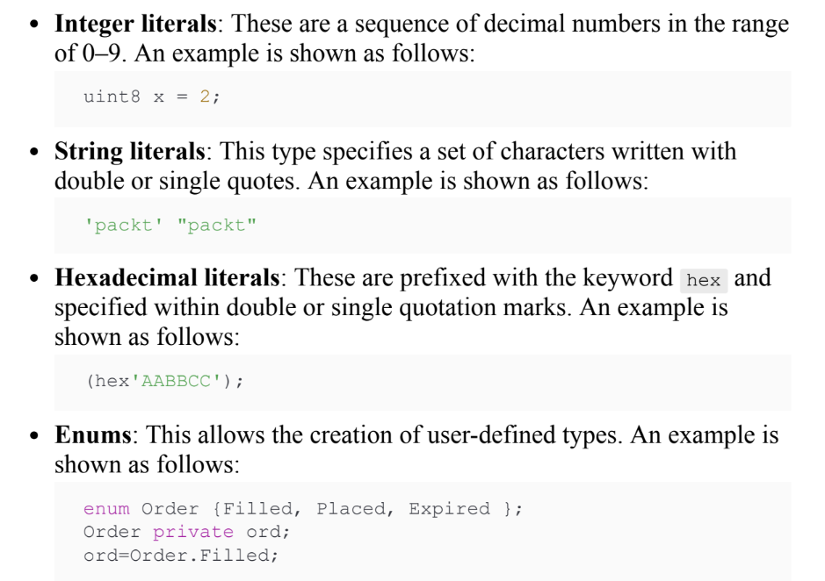
Data Types
Literals -
to represent a fixed value

Slide 50
Reference types
include arrays, structs, and mappings
Arrays - contiguous set of elements of the same size and type
Arrays have two members, named length and push
Structs - used to group a set of dissimilar data types under a logical group

Slide 51
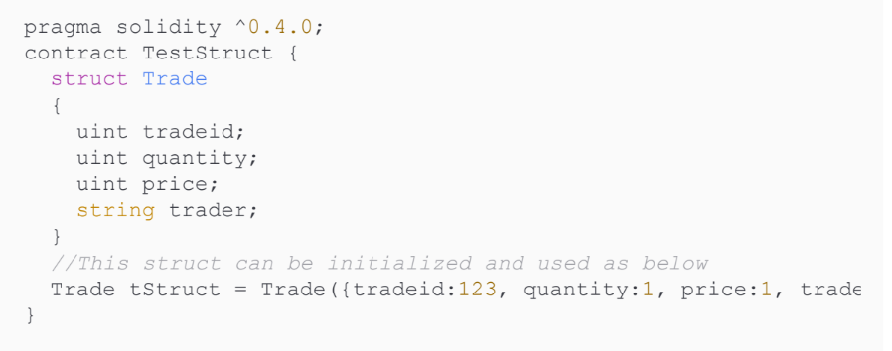

Slide 52
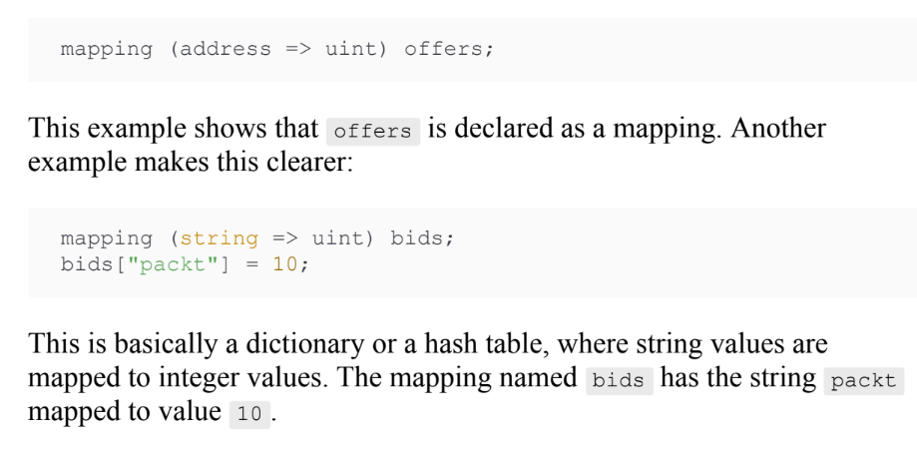
Reference types
Mappings - used for a key-to-value mapping

Slide 53
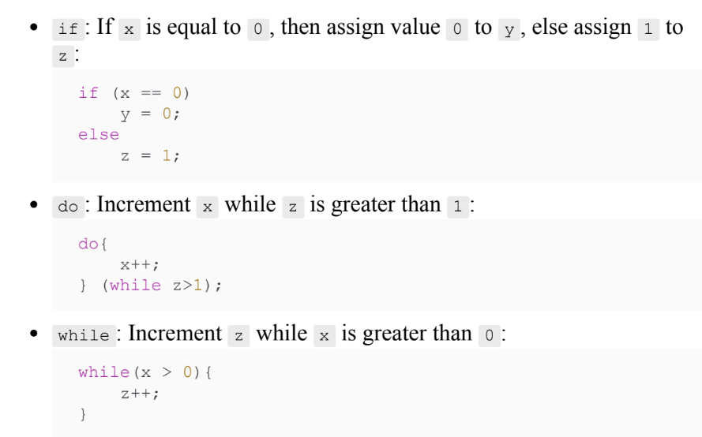
Control
Structures

Slide 54
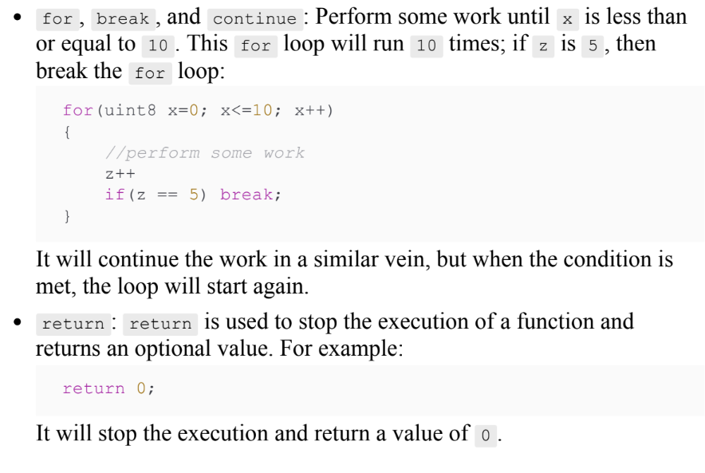
Control
Structures

Slide 55
Events
used to log certain events in EVM logs
useful when external interfaces are required to be notified of any change or event in the contract
These logs are stored on the blockchain in transaction logs
Logs cannot be accessed from the contracts but are used as a mechanism to notify change of state or the occurrence of an event (meeting a condition) in the contract

Slide 56
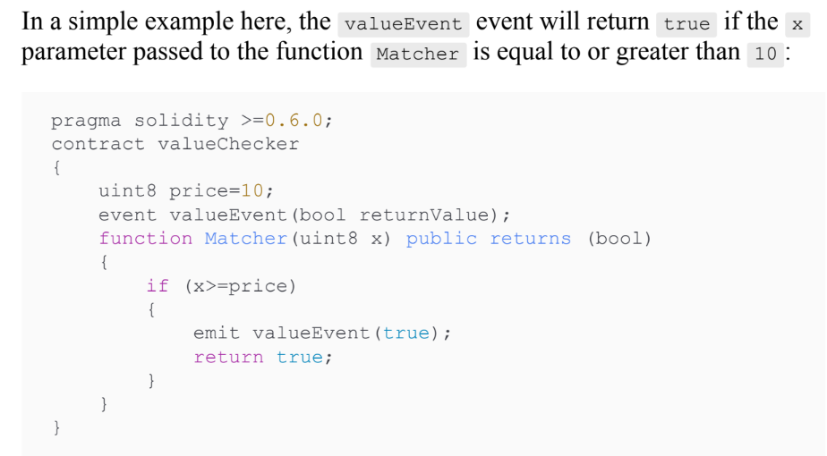

Slide 57
Inheritance
is keyword is used to derive a contract from another contract
derived contract has access to all non-private members of the parent contract

Slide 58
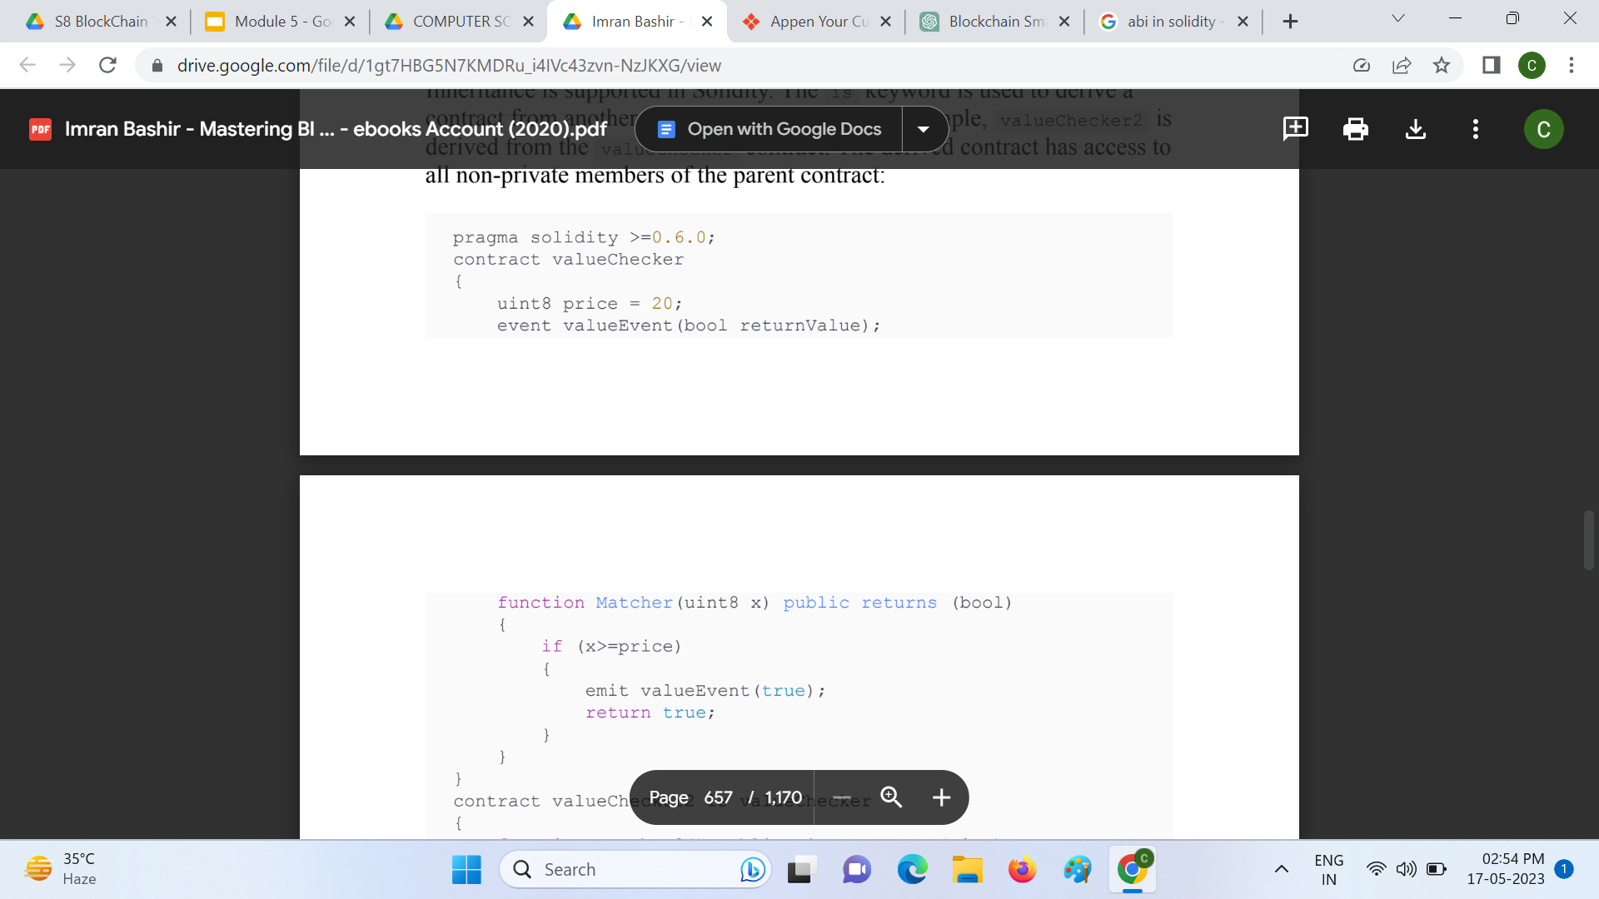
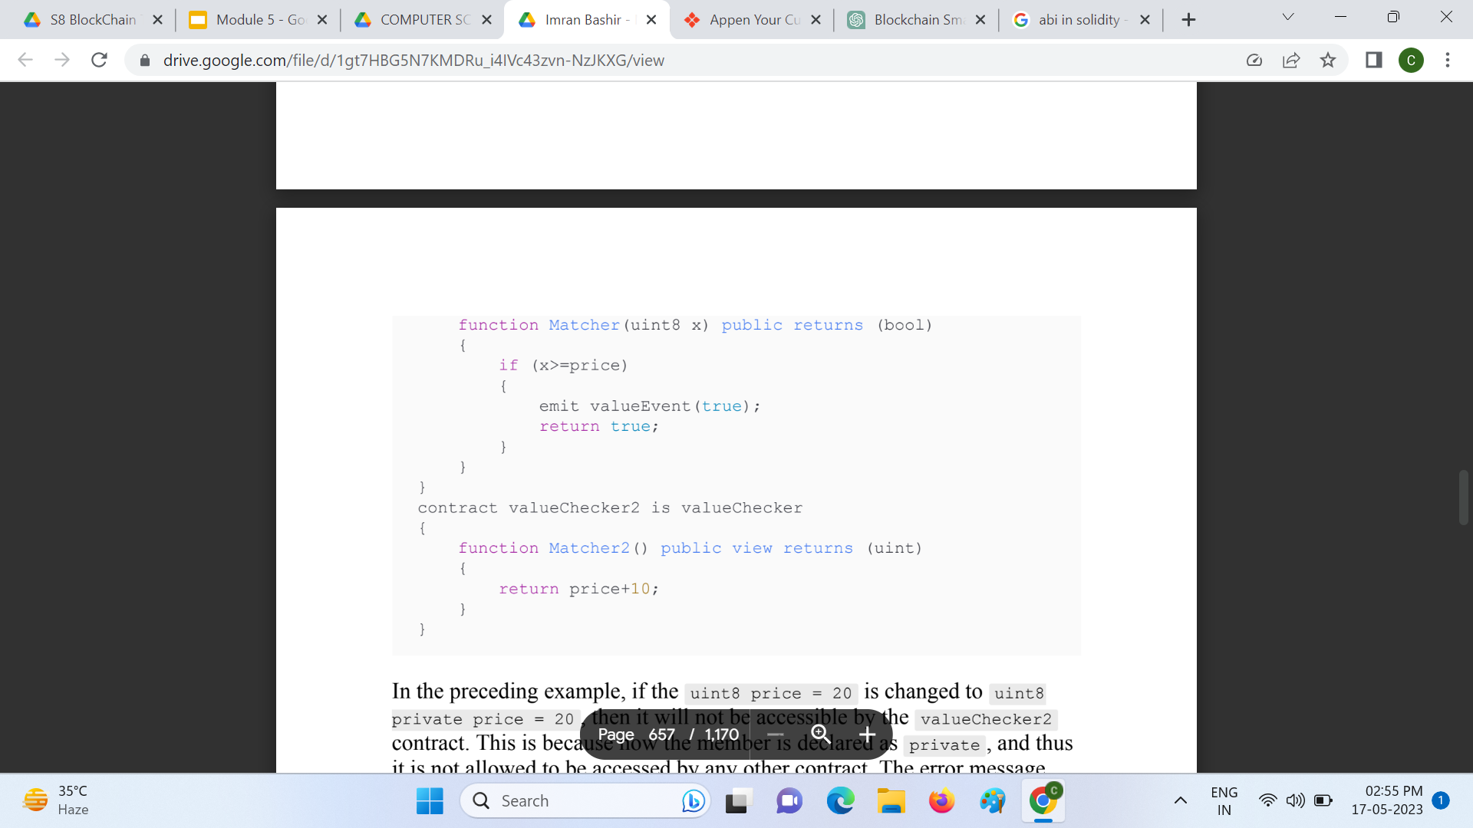

Slide 59
Libraries
deployed only once at a specific address and their code is called via the CALLCODE or DELEGATECALL opcode of the EVM
code reusability
similar to contracts and act as base contracts to the calling contracts

Slide 60
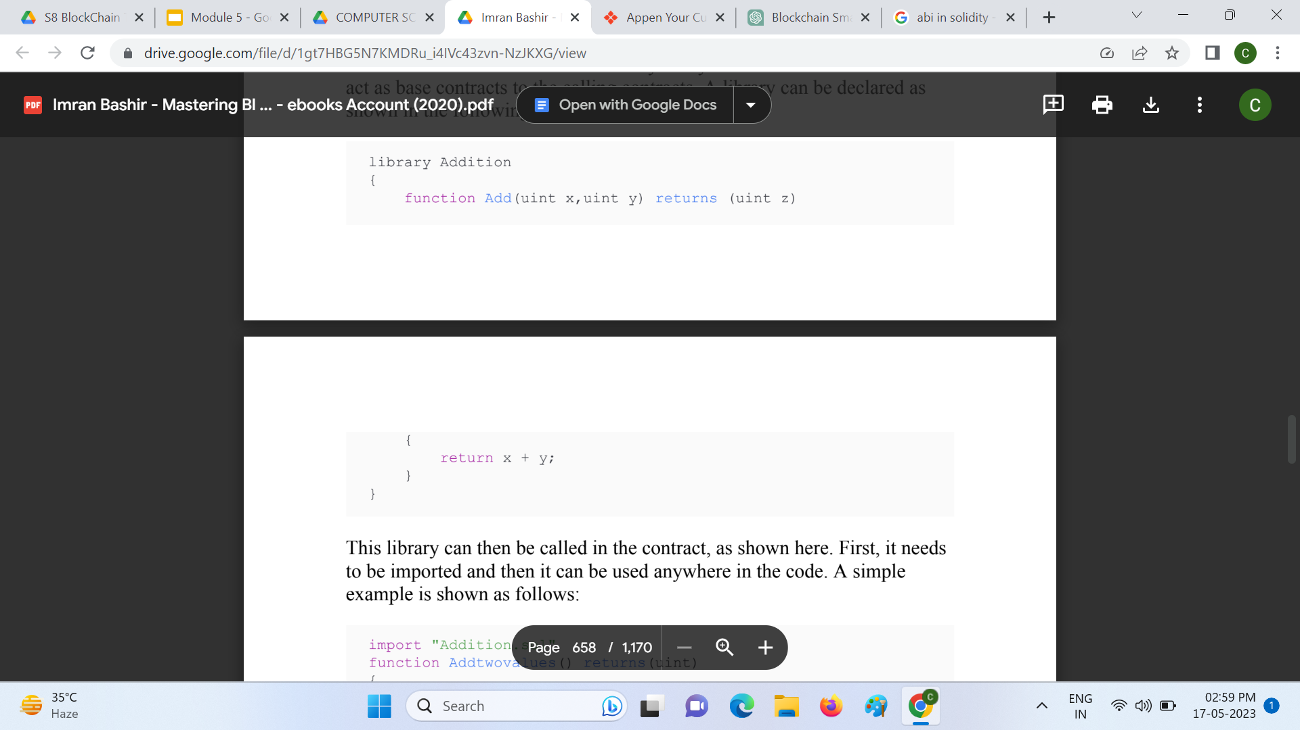
Library declaration

Slide 61
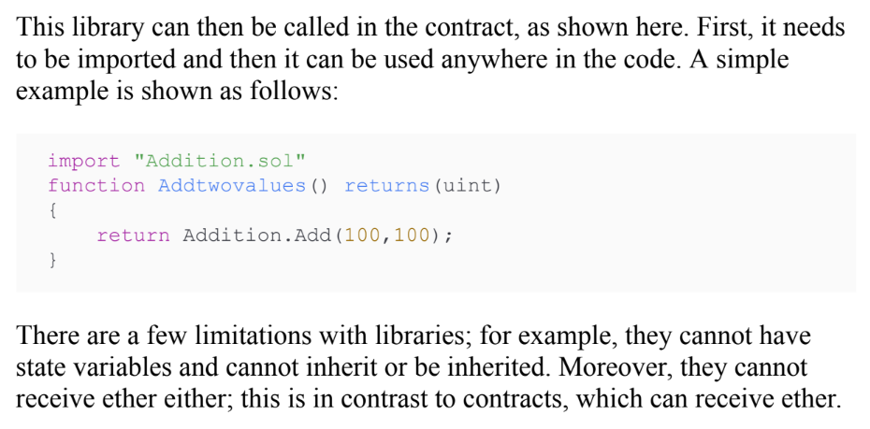

Slide 62
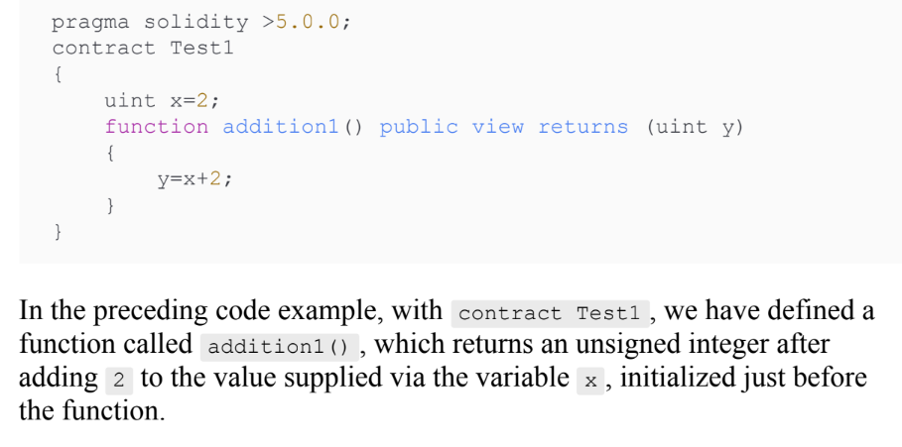
Functions

Slide 63
Functions
Two types
Internal functions - used only within the context of the current contract
External functions - called via external function calls
A function in Solidity can be marked as a constant
Constant functions cannot change anything in the contract; they only return values when they are invoked and do not cost any gas

